Slide 1
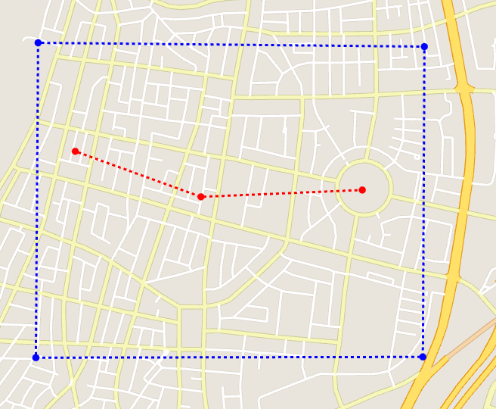
ex_feature_tel-aviv2.xml

Slide 2
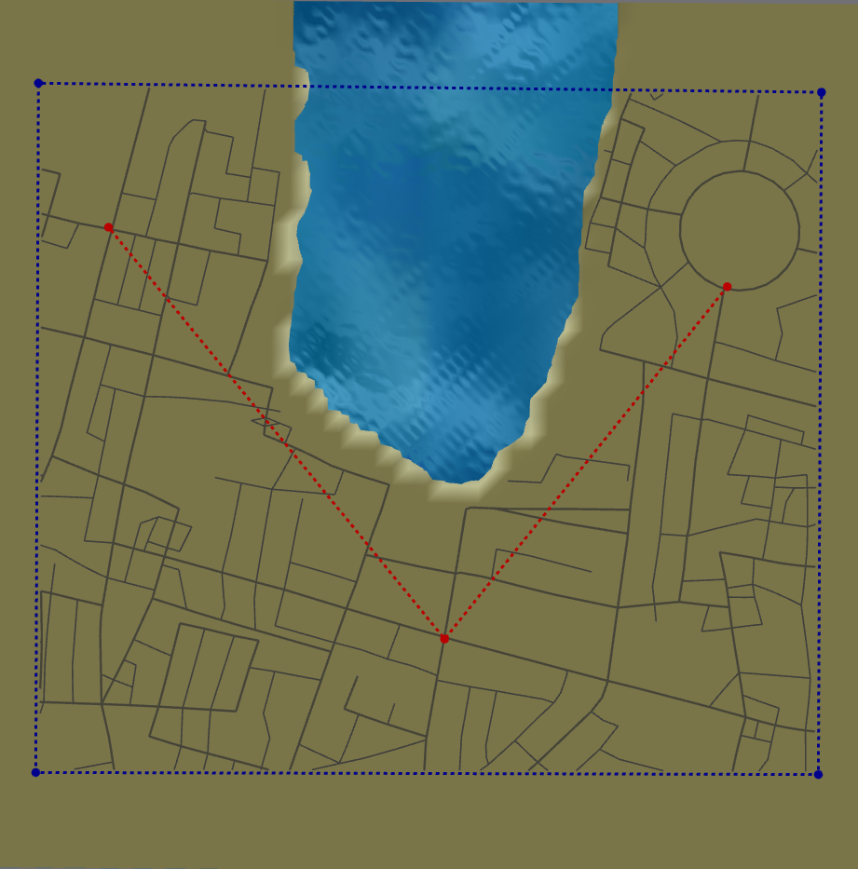
1. Weird Shape Fitting

